Slide 1
Executive summary
Project Overview: Learning to Label – From Clustering to Classification
Objective: Build a pipeline to auto-generate labels using clustering and train classifiers using those pseudo-labels.
Domains covered: Text classification and Image classification on unlabelled datasets.
Core pipeline:
- Feature Engineering (HOG / Word2Vec / TF-IDF)
- Dimensionality Reduction (PCA)
- Unsupervised Label Generation (KMeans)
- Visualization (t-SNE)
- Classification Models (SVM, KNN, RF, Neural Networks)

Slide 2
Executive summary
Clustering-Driven Text Classification
Objective: Categorize unlabeled text data using clustering and classify using supervised models.
Dataset Setup:
- Initial exploration with libraries like pickle, numpy, pandas.
- Visualized and inspected raw documents.
Preprocessing Steps:
- Text cleaning: lowercasing, punctuation/special character removal, HTML tag removal (BeautifulSoup).
- Tokenization and stopword removal (using NLTK).
- Stemming and lemmatization applied to normalize text data.
Vectorization Techniques:
- Applied TF-IDF, Word2Vec – CBOW, and Skip-gram.
- Chose CBOW based on superior cosine similarity between word vectors.
Clustering:
- Used KMeans after PCA to discover structure in text data.
- Generated pseudo-labels for classification.
Classification Models:
- Logistic Regression: 91% accuracy
- K-Nearest Neighbors (KNN): 98% accuracy
- Random Forest: 97% accuracy (after integer conversion of float predictions)
Model Chosen: KNN, due to highest accuracy.

Slide 3
Executive summary
Clustering-Driven Image Classification
Objective: Classify images by generating pseudo-labels through clustering, then applying supervised learning.
Dataset Setup:
- Used libraries like numpy and pandas for loading and inspecting the image data.
- Dataset shape: (60000, 1, 28, 28) – required reshaping and processing.
Preprocessing Steps:
- Removed channel dimension → (60000, 28, 28)
- Flattened images → (60000, 784)
- Normalized pixel values to [0, 1] for ML compatibility
Feature Engineering:
- Applied HOG (Histogram of Oriented Gradients) to extract texture/edge features.
- Transformed each image to a 144-dimensional HOG feature vector.
Dimensionality Reduction:
- Applied PCA to HOG features, reducing to 100 dimensions while retaining most variance.
Clustering:
- KMeans applied to PCA output → 10 clusters (0–9) generated.
- Output: cluster assignments (shape: (60000,)), cluster centers (shape: (10, 100))
Visualization:
- Used t-SNE on 10,000 PCA vectors to visualize cluster separability.
- Clusters like 0, 6, 9 well-separated; others (1, 3, 5) showed overlap.
Classification Models:
- SVM (linear & RBF), Random Forest (3 variants), Neural Networks (3 configs).
- Top accuracy: Random Forest (min_samples_leaf=3): 95%
Neural Network (5 neurons): 94%
Models Chosen: Random Forest 3 and Neural Network 1 for best balance of accuracy and generalization.

Slide 4
Text classification

Slide 5





Text Classification
Collecting the dataset
Preprocessing
Vectorization
Clustering
Classification

Slide 6
Dataset description
Total Documents: 1,500
Categories: 5 distinct document categories
Format: .pkl (Pickle) file – Python object serialization format
Content Type: Textual documents
Purpose: Text classification and similarity analysis

Slide 7
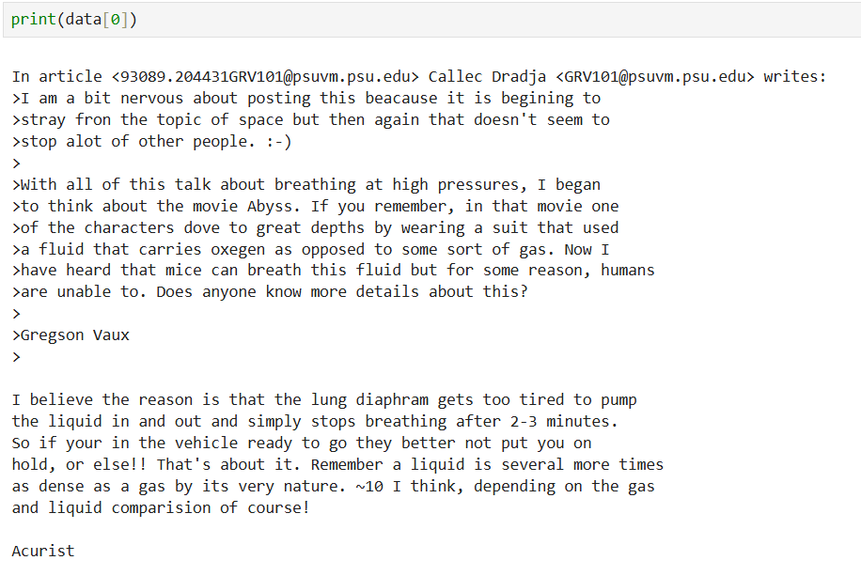
Dataset Description
Import the necessary libraries, ex: pickle, numpy, pandas, etc.
Check the data type and print the document in the dataset (as given in the figure).
Then move to preprocessing steps

Slide 8
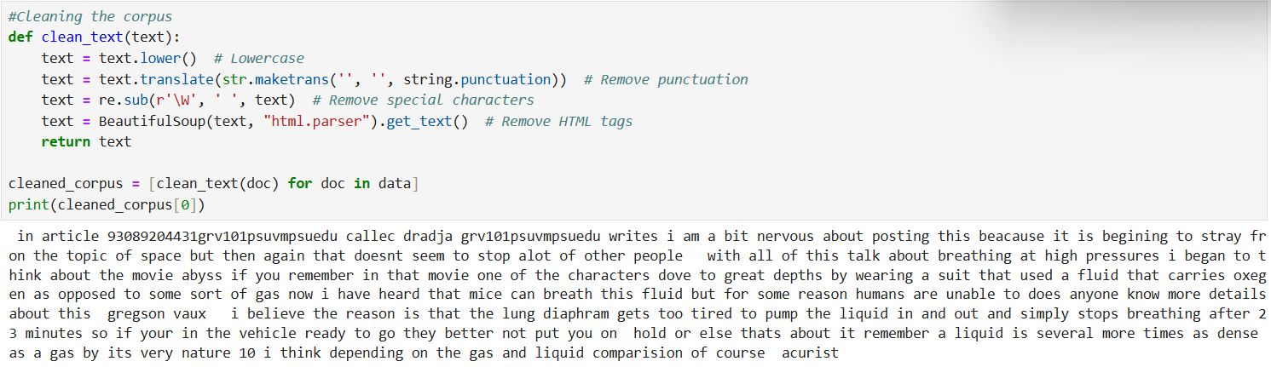
Pre-process the dataset
Clean the corpus:
Convert the text to lowercase.
Remove the punctuations.
Remove the special characters using regular expression.
Remove the HTML tags using beautiful soup library.

Slide 9
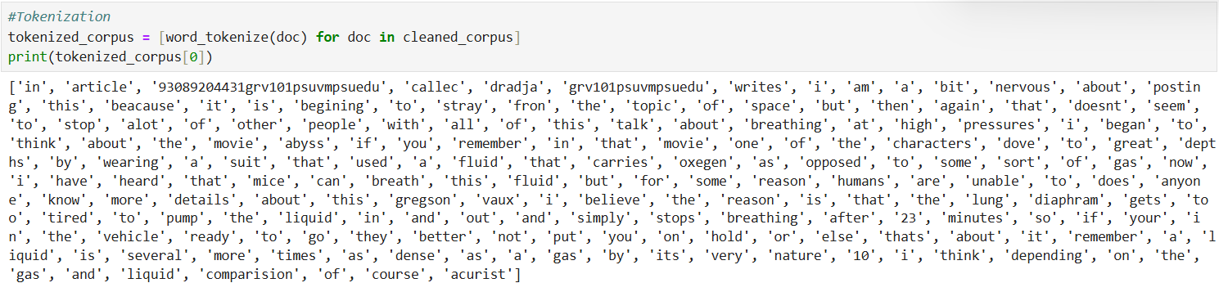
Pre-process the dataset
Tokenization:
Convert the text corpus into tokens as given below.

Slide 10
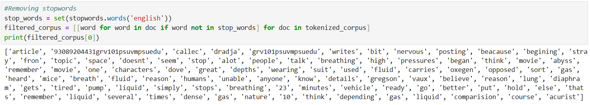
Pre-process the dataset
Remove the stop words:
Download the stop words package from nltk library.
Use this library to remove the stop words from the tokenized corpus.

Slide 11
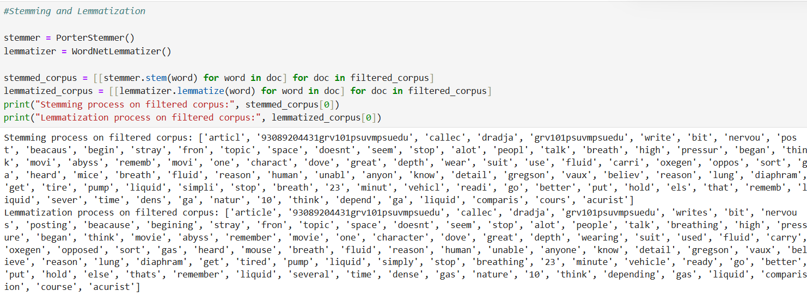
Pre-process the dataset
Stemming and lemmatization:
Use the required packages to perform stemming and lemmatization function on the filtered corpus.
Stemming – Converts the tokens into it’s root word.
Lemmatization – Converts the tokens into present tense.

Slide 12
Vectorization
The process of converting text data into numerical vectors.
These numerical representations, or word vectors, capture the semantic meaning and relationships between words, making them usable by machine learning algorithms.
Methods used in this project:
Word2Vec – CBOW
Word2Vec – Skip gram
TF-IDF

Slide 13
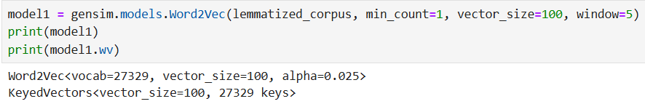
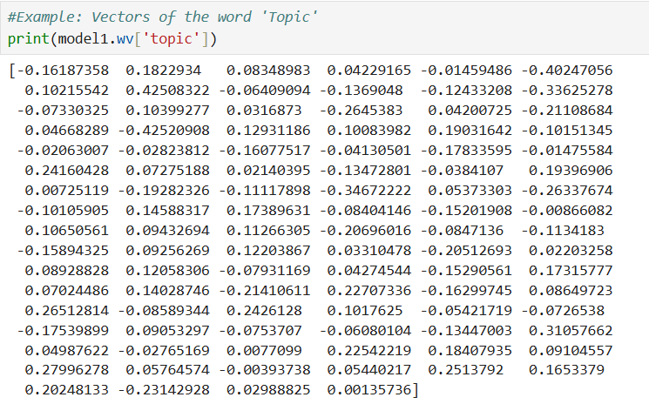
Vectorization
Vectorization process done using Word2Vec: CBOW method
Vectors obtained after performing Word2Vec function:

Slide 14
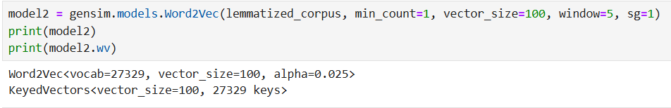
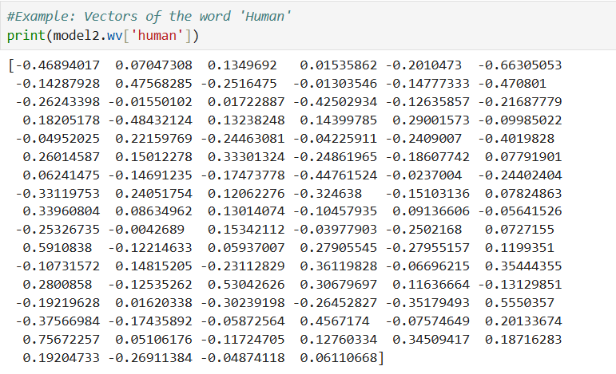
Vectorization
Vectorization process to be done using Word2Vec: Skip Gram method
Vectors obtained after performing Word2Vec function:

Slide 15
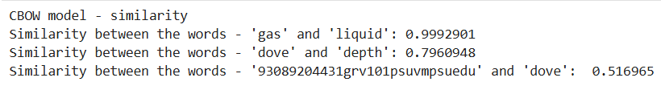
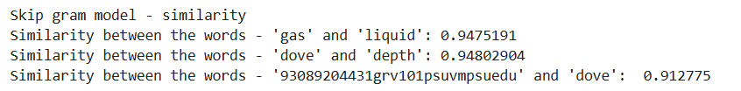
Vectorization
Similarity score comparison between CBOW and Skip Gram methods.
We chose CBOW method since it depicted the similarity between the words properly than Skip Gram method.

Slide 16
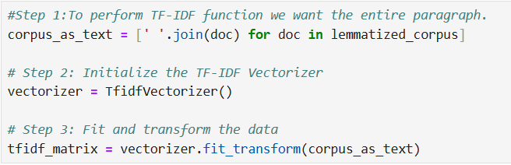
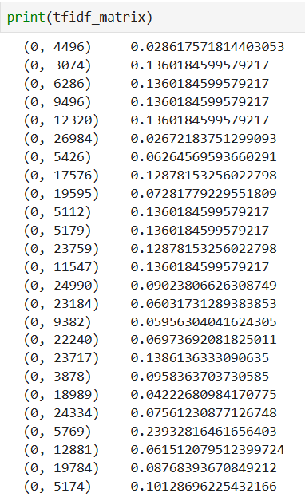
Vectorization
Vectorization process to be done using TF-IDF:
Vectors obtained after performing TF-IDF function:

Slide 17
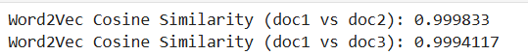
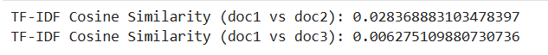
Vectorization
Comparing the Word2Vec – CBOW method and TF-IDF method using cosine similarity.
There is a huge difference in the cosine similarity score between Word2Vec and TF-IDF methods for the same document. This is due to various conditions like,
Considering these reasons, Word2Vec – CBOW method is the best approach for this dataset.
Aspect | Word2Vec (Average) | TF-IDF
Representation | Dense vectors from a neural model | Sparse vectors with term-frequency
Context | Captures semantic relationships | Captures keyword overlap
Similarity Basis | Semantic meaning (word meanings) | Word occurrence importance
Vector Scale | Dense vectors often have smaller variance | Sparse vectors often have large variance

Slide 18
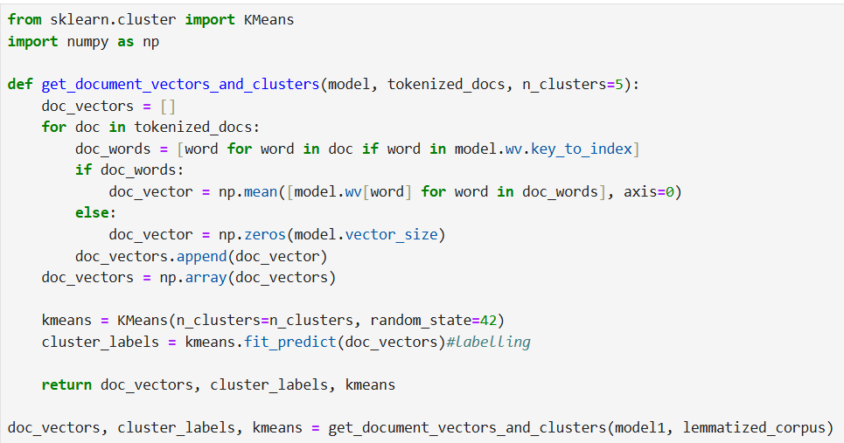
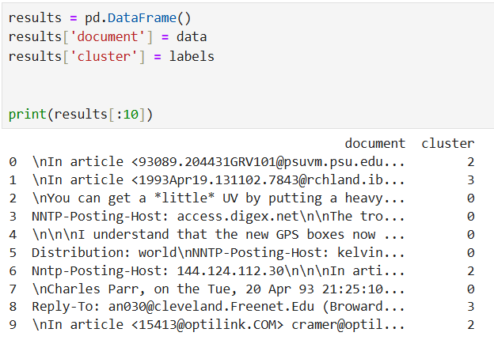
Clustering the data points
KMeans algorithm is used for this dataset.

Slide 19
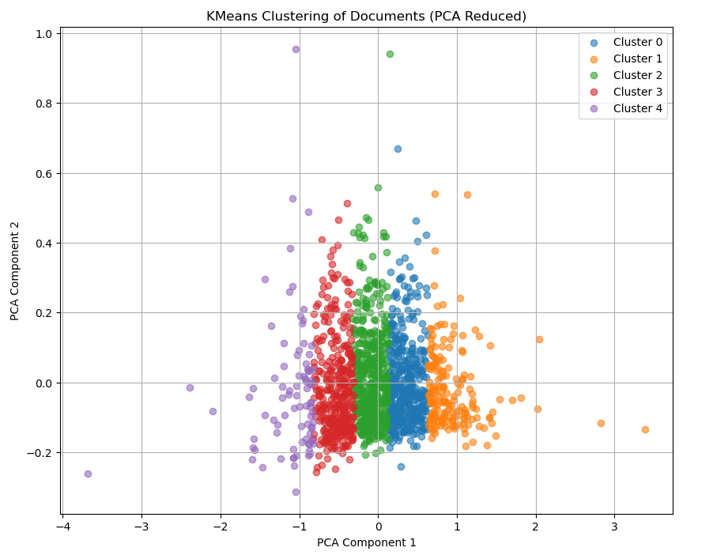
Clustering the data points
Visualising the data points after reducing the dimensions using PCA

Slide 20
Classification
Split the data into training and testing set.
Classification models used:
Logistic Regression
KNN
Random Forest

Slide 21
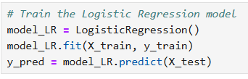
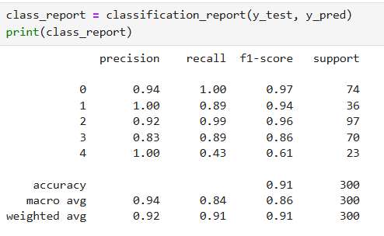
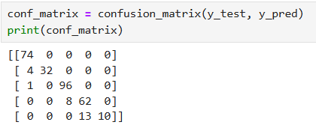
Classification
Logistic Regression model:
Evaluation metrics:
Accuracy of Logistic regression model is 91%

Slide 22
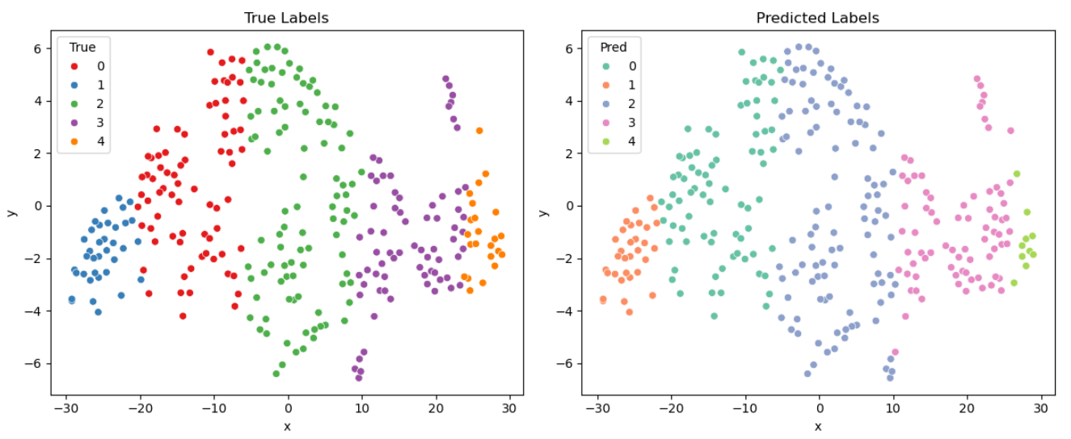
Classification
Visualizing the prediction of Logistic Regression model:

Slide 23
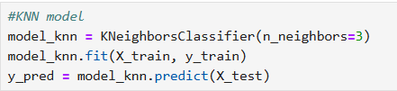
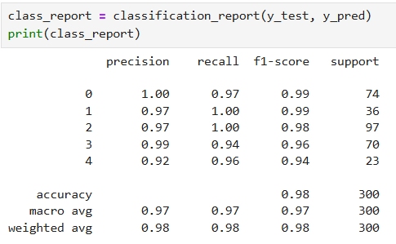
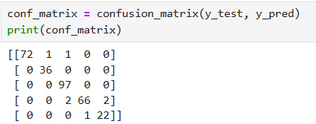
Classification
KNN model:
Evaluation metrics:
Accuracy of KNN model is 98%

Slide 24
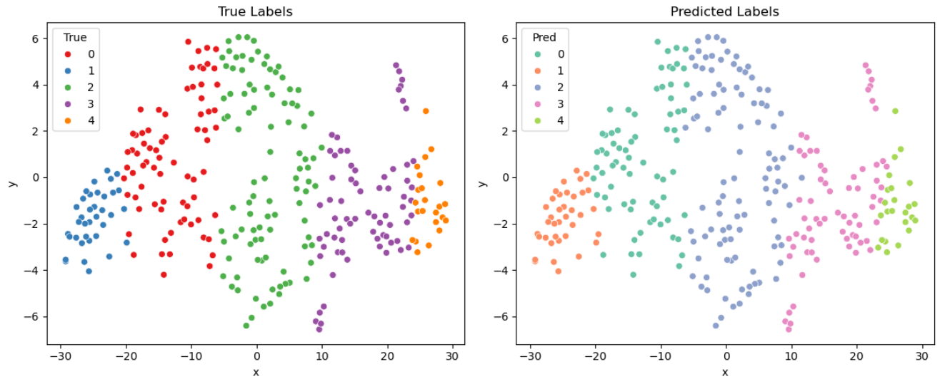
Classification
Visualizing the prediction of KNN model:

Slide 25
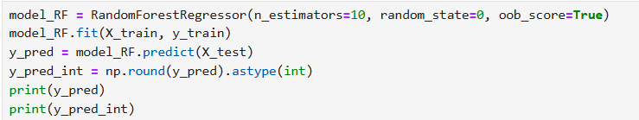
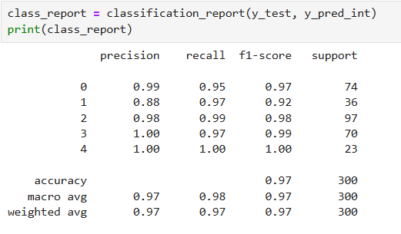
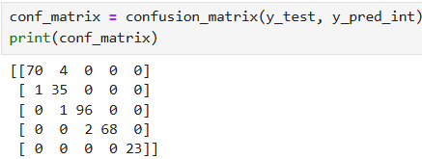
Classification
Random Forest model:
Random forest method produces output in the form of float values which cant be used to evaluate, so we convert the float into integer and then evaluate the model.
Evaluation metrics:
Accuracy of Logistic regression model is 97%

Slide 26
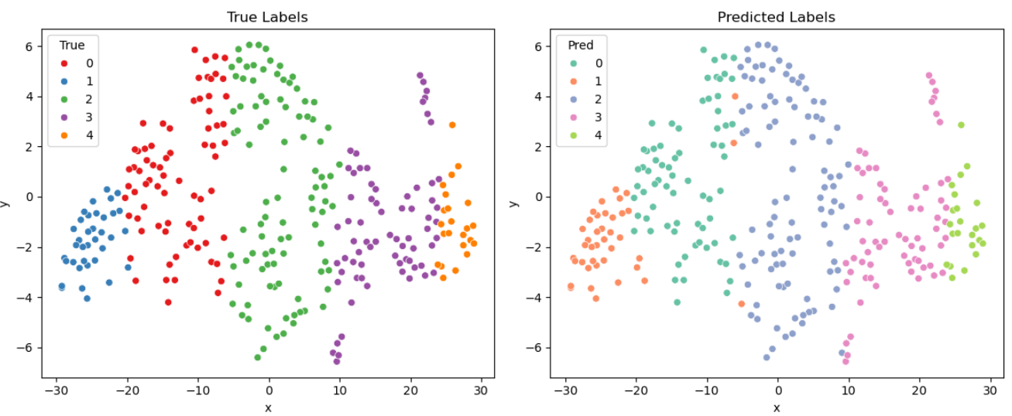
Classification
Visualizing the prediction of Random Forest model:

Slide 27
Classification
KNN model gives better accuracy for this dataset compared to the other 2 models, So KNN model is chosen.

Slide 28
Image classification

Slide 29
Image Classification
Collecting the dataset
Dimensionality reduction
Clustering
Labelling
Classification

Slide 30
Dataset description
Total Images: 60,000
Categories: 10 distinct categories of handwritten text
Format: .npy (Numpy) file – Python object serialization format
Content Type: Imges 28x28 pixels
Purpose: train and evaluate image classification algorithms

Slide 31
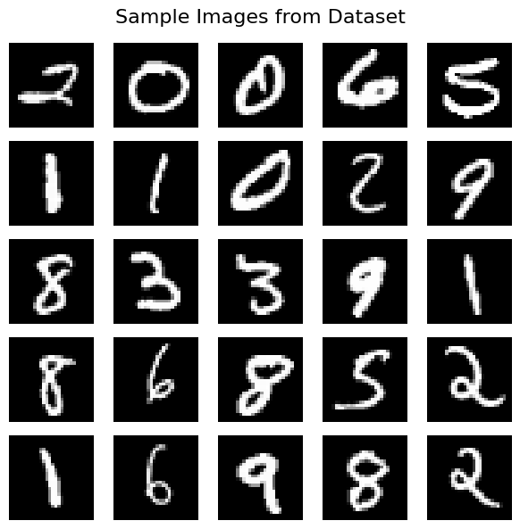
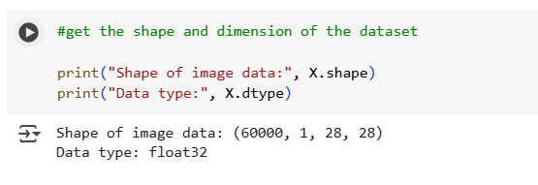
Dataset Description
Import the necessary libraries, ex: numpy, pandas, etc.
Check the data type and print the images in the dataset (as given in the figure).
Then move to preprocessing steps

Slide 32
Image Data pre-processing
Remove the extra dimension
Flatten and normalize
Apply Hog Transformation for feature engineering.
PCA for dimensionality reduction.

Slide 33
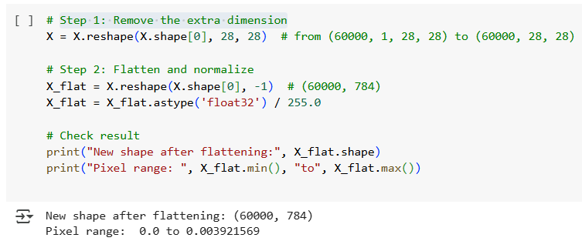
Image Data pre-processing
Faltteing and normalizing.
To convert (60000, 1, 28, 28) into standard 2D image format (60000, 28, 28) for easier processing
To reshape 2D image pixels into 1D vectors required by most ML algorithms like PCA and KMeans
To scale pixel intensity from [0, 255] to [0, 1] for numerical stability and better clustering performance.
• Removed channel dimension → shape: (60000, 28, 28)
• Flattened images to vectors → shape: (60000, 784)
• Normalized pixel values → [0, 1]
• Removed channel dimension → shape: (60000, 28, 28)
• Flattened images to vectors → shape: (60000, 784)
• Normalized pixel values → [0, 1]

Slide 34
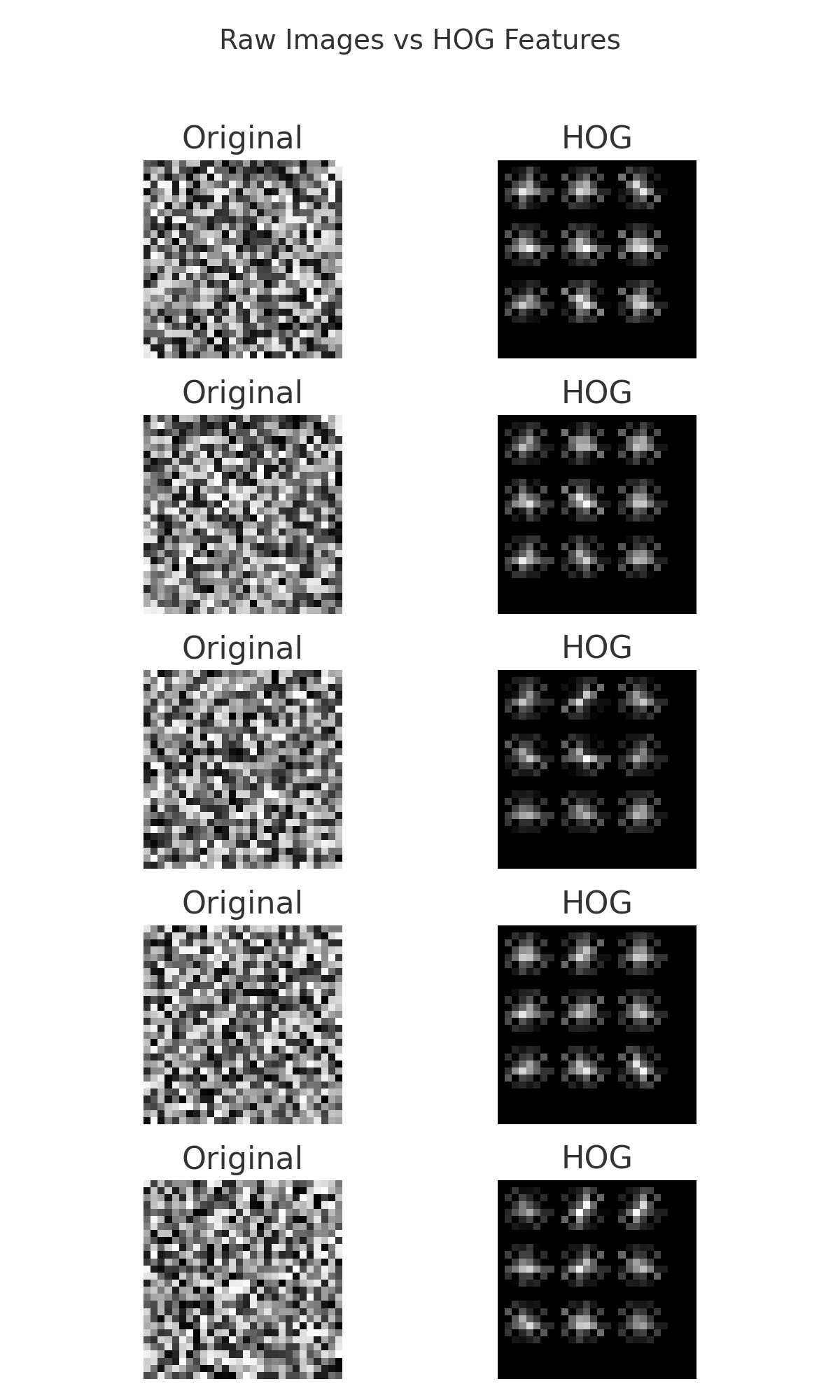
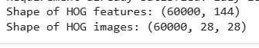
Image Data pre-processing
Hog Transformation
To extract edge and texture features that capture the structural shape of digits for better clustering and classification
After flattening and normalizing, we structured the image data for machine learning compatibility.
Applying HOG further transformed each image into a 144-length feature vector capturing edge and texture patterns, ideal for clustering and classification.

Slide 35
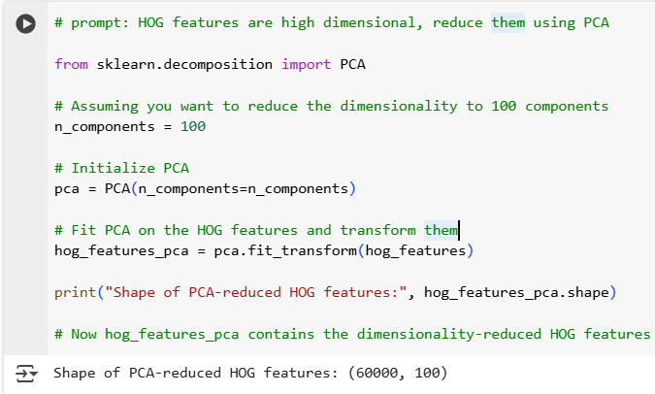
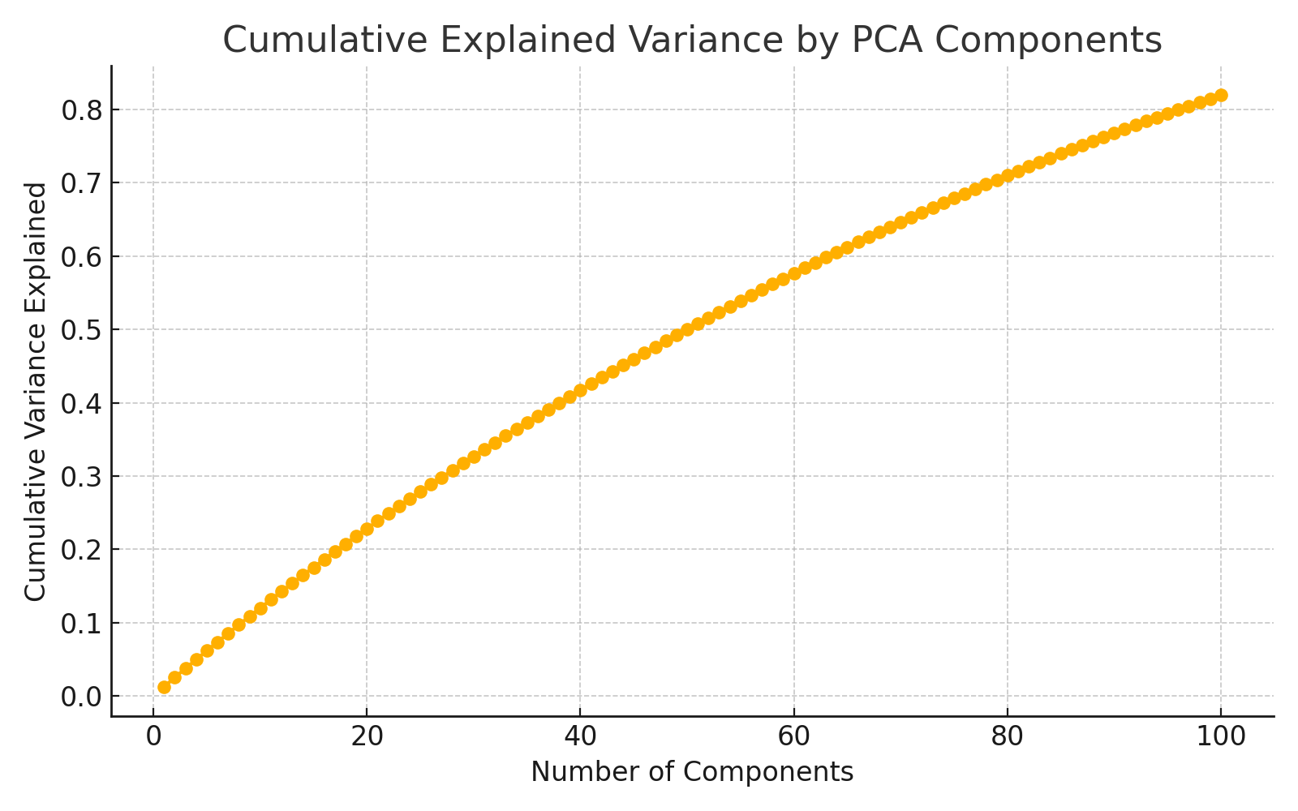
Image Data pre-processing
PCA for dimensionality reduction
PCA was applied to the 144-dimensional HOG feature vectors to reduce them to 100 principal components.
This retained most of the meaningful variance while making the data more compact and efficient for clustering and classification.

Slide 36
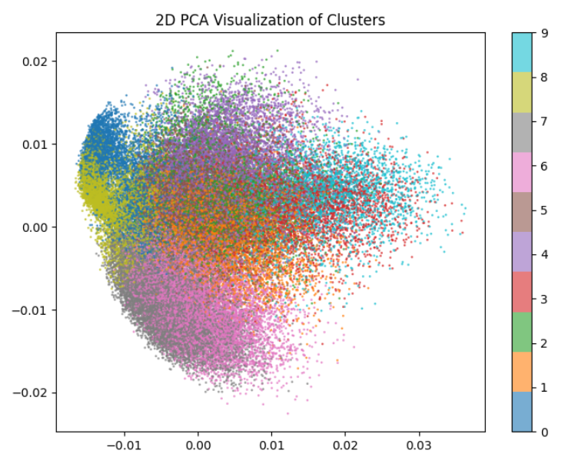
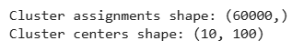
Clustering with K-Means
KMeans clustering was applied on the PCA-reduced HOG features (shape: (60000, 100)), successfully grouping the dataset into 10 clusters.
It produced cluster assignments for all 60,000 images (shape: (60000,)) and identified 10 cluster centers (shape: (10, 100)), each representing a pseudo-label from 0 to 9.

Slide 37
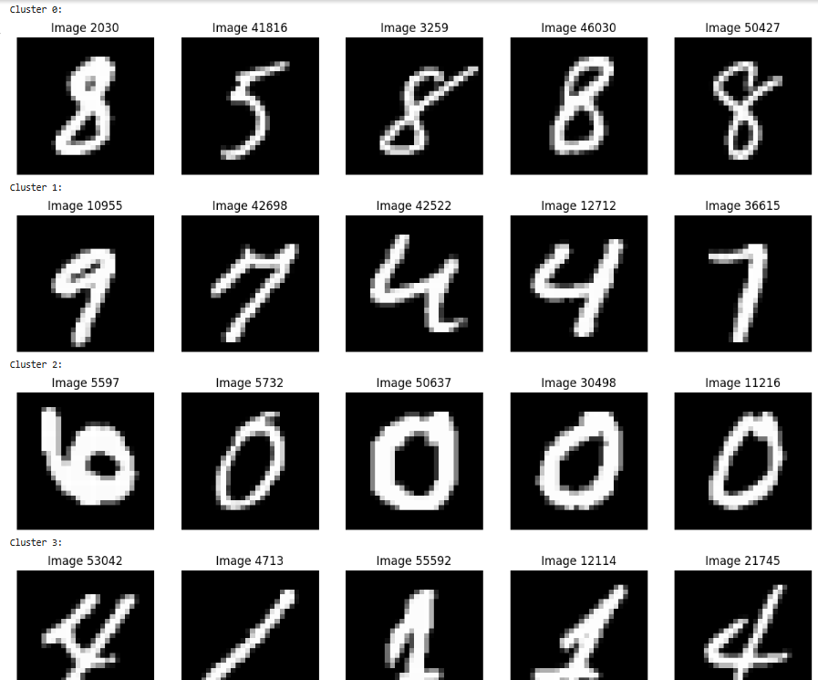
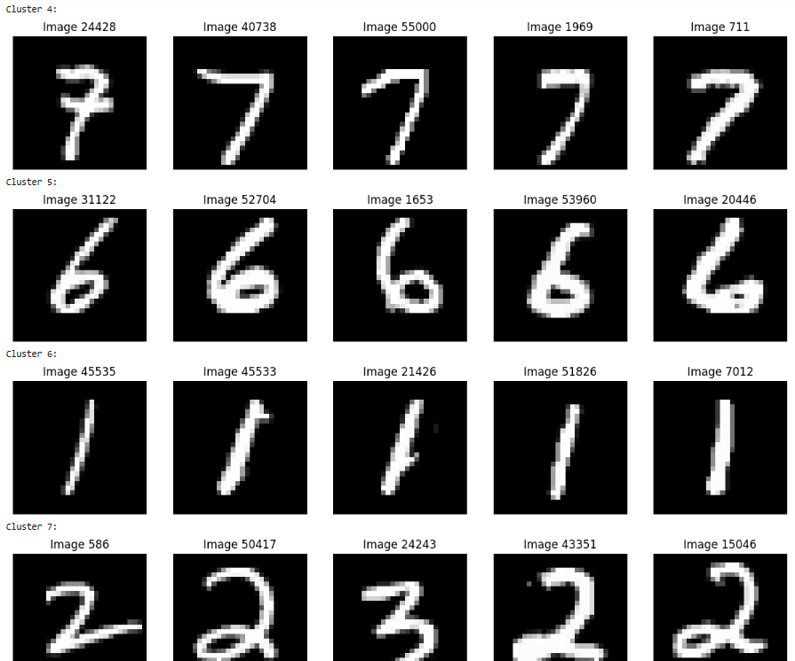
Clustering with K-Means
Sample clustered data:

Slide 38
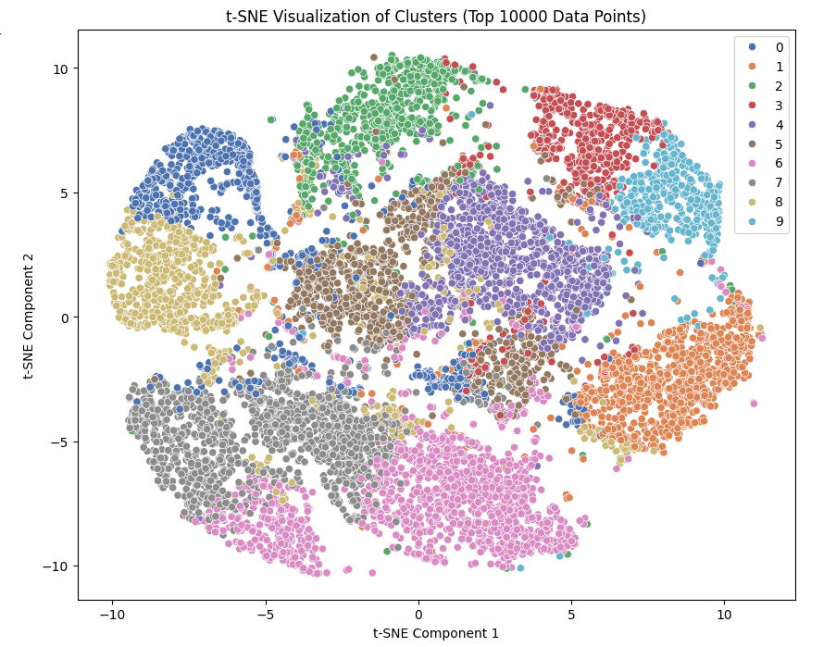
t-NSE for visualization
t-SNE is a dimensionality reduction technique used for visualizing high-dimensional data in 2D or 3D while preserving local structure.
We applied t-SNE on the top 10,000 PCA-reduced HOG features to explore the cluster separability learned by KMeans.
The plot shows that while some clusters (like 0, 6, 9) are well-separated, others (like 1, 3, 5) have overlaps, indicating class similarity or labeling noise.

Slide 39
Classification
Split the data into training and testing set.
Classification models used:
SVC Classifier 1 : kernel = linear
SVC Classifier 2 : kernel = rbf
Random forest Classifier 1 : min_samples_leaf = 1
Random forest Classifier 2 : min_samples_leaf = 3
Random forest Classifier 3 : min_samples_leaf = 5
Neural Network Classifier 1 = hidden_layer_sizes = (5)
Neural Network Classifier 2 = hidden_layer_sizes = (5,5)
Neural Network Classifier 3 = hidden_layer_sizes = (5,5,5)

Slide 40
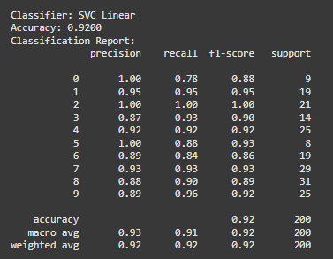
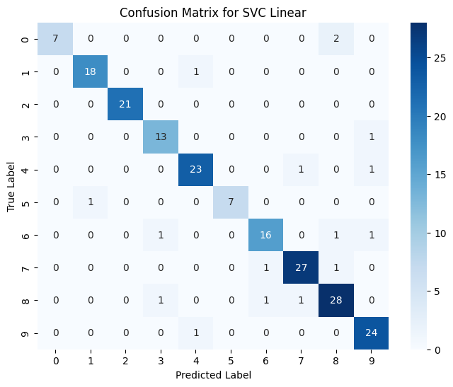
Classification
Accuracy is 92% Support is weak High precision and recall for class 7 and 8

Slide 41
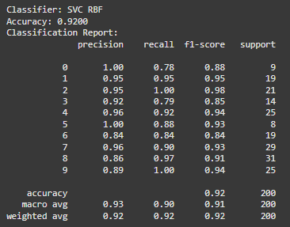
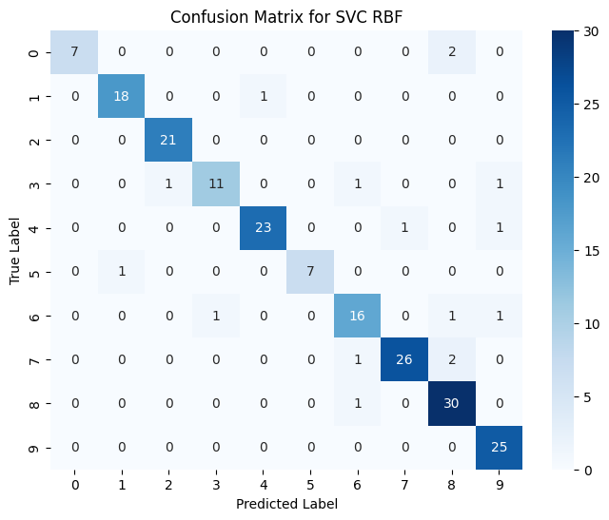
Classification
Accuracy is 92% Support is weak High precision and recall for class 7 and 8

Slide 42
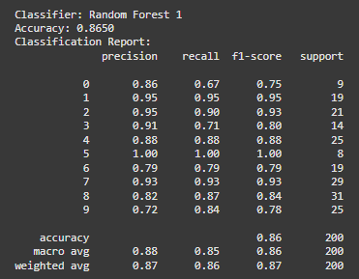

Classification
Accuracy is 86% Support is weak High precision and recall for class 7 and 8

Slide 43
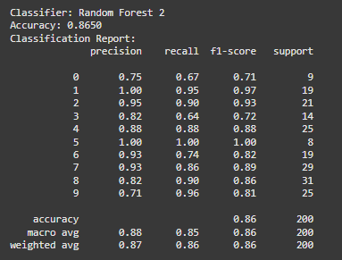
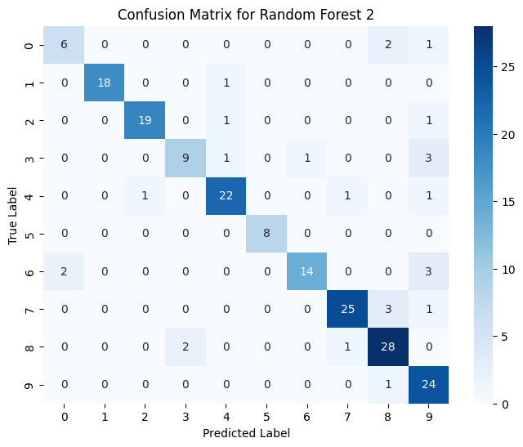
Classification
Accuracy is 86% Support is weak High precision and recall for class 7 and 8 Misclassification seen for cluster9

Slide 44
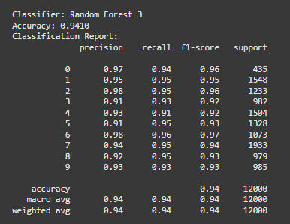

Classification
Accuracy is 94% Support is strong High precision and recall for class 7 Misclassification seen for cluster 1,2,3,4 and 7

Slide 45


Classification
Accuracy is 95% Support is strong High precision and recall for class 7 Misclassification high for cluster 5 and 6

Slide 46


Classification
Accuracy is 73% Support is weak High precision and recall for class 7 and 8

Slide 47


Classification
Accuracy is 86% Support is weak High precision and recall for class 7 and 8 wrong prediction: 9th cluster is predicted as cluster 8

Slide 48
Conclusion
Random forest 3 and Neural network 1 give the best performance compared to other 6 models. Therefore Random forest 3 and Neural network 1 are chosen.

